Slide 1
Automatic Speech Recognition
Kumar Shantam

Slide 2
Problem Statement
Speech is the primary form of human communication and is also a vital part of understanding behavior and cognition.
Speech Recognition in Artificial Intelligence is a technique deployed on computer programs that enables them in understanding spoken words.
A general Speech Recognition system is designed to perform the tasks mentioned below and can easily be correlated with a standard data analytics architecture:
The capture of speech (words, sentences, phrases) given by a human. You can think of this as the Data Acquisition part of any general Machine Learning workflow.
Transforming audio frequencies to make it machine-ready. This process is the data pre-processing part where we clean features of the data for the machine to process it.
Application of Natural Language Processing (NLP) on the acquired data to understand the content of speech.
Synthesis of the recognized words to help the machine speak a similar dialect.
Improve the semantic model or language Model to make predictions better.

Slide 3
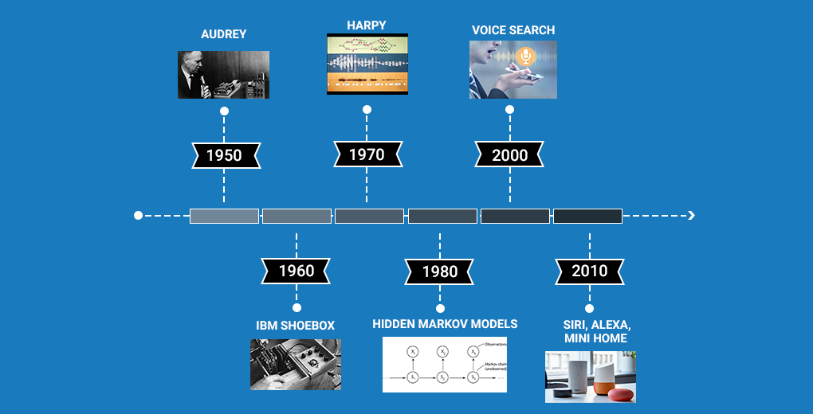
Timeline: Development of Speech Recognition systems.
Source

Slide 4
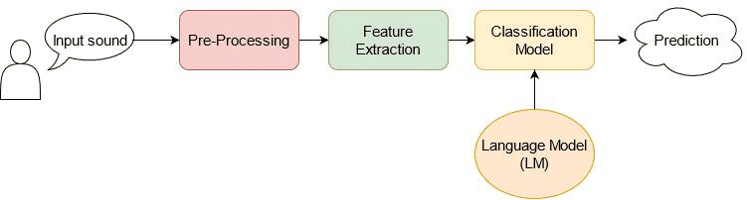
Signal processing: Basics
Overview of an ASR system Source

Slide 5
Signal Processing: Basics
Sampling: It is a procedure used to convert a time-varying (changing with time) signal s(t) to a discrete progression of real numbers x(n). Common sampling frequencies are 8 kHz, 16 kHz, and 44.1 kHz. Higher the sampling rates mean better signal quality.
Quantization: Process of replacing every real number generated by sampling with an approximation to obtain a finite precision (defined within a range of bits). In the majority of scenarios, 16 bits per sample are used for the representation of a single quantized sample. Therefore, raw audio samples generally have a signal range of -215 to 215 although, during analysis, these values are standardized to the range (-1, 1) for simpler validation and model training.
Time Domain Signals: The audio signal is represented by the amplitude as a function of time. The features are the amplitudes which are recorded at different time intervals. The limitation of the time-domain analysis is that it completely ignores the information about the rate of the signal which is addressed by the frequency domain analysis.
Frequency Domain Signals: the audio signal is represented by amplitude as a function of frequency. The limitation of this frequency domain analysis is that it completely ignores the order or sequence of the signal which is addressed by time-domain analysis.

Slide 6
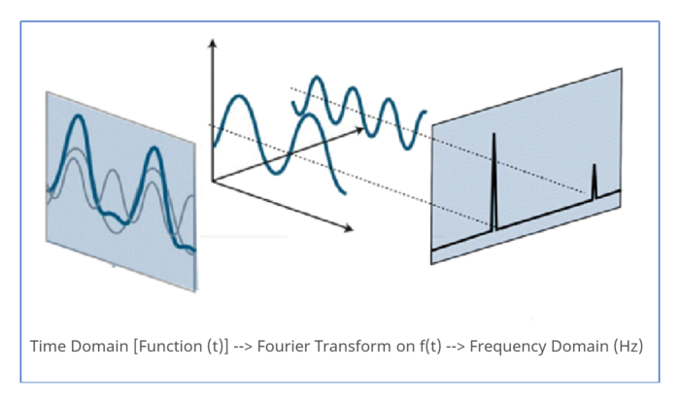
Signal Processing: Basics
Spectrogram: A 2-D plot between time and frequency where each point in the plot represents the amplitude of a particular frequency at a particular time in terms of intensity of color. The spectrogram is a spectrum (broad range of colors) of frequencies as it varies with time.
Fourier Transforms: Fourier Transforms is a mathematical concept that can decompose this signal and bring out the individual frequencies. This is vital for understanding all the frequencies (amplitude) that are combined together to form the sound we hear. Numpy has a library to convert a sequence to a Discrete Fourier Transform- np.fft.fft.

Slide 7
Data Preprocessing and EDA
There are a number of open source annotated datasets available pertaining to use case at hand.
TIMIT: TIMIT is a large dataset with broadband recordings from American English, where each speaker reads 10 grammatically rich sentences. TIMIT contains audio signals, which have been time-aligned, corrected and can be used for character or word recognition. The audio files are encoded in 16 bits. The training set contains a large number of audios from 462 speakers in total, while the validation set has audios from 50 speakers and the test set audios from 24 speakers.
LJ speech: A public domain speech dataset consisting of 13,100 short audio clips of a single speaker reading passages from 7 non-fiction books. A transcription is provided for each clip. Clips vary in length from 1 to 10 seconds and have a total length of approximately 24 hours.
Audio MNIST: The dataset consists of 30,000 audio samples of spoken digits (0–9) from 60 different speakers. Additionally, it holds the audioMNIST_meta.txt, which provides meta information such as the gender or age of each speaker.
JL Corpus: Emotional speech in New Zealand English. This corpus was constructed by maintaining an equal distribution of 4 long vowels. The corpus has five secondary emotions along with five primary emotions.
More datasets can be found here.

Slide 8
Data Preprocessing and EDA
The main goal of an ASR system is to transform an audio input signal f{x} = (x_1, x_2, … x_T) with a specific length T into a sequence of words or characters (i.e., labels) f{y} = ( y_1, y_2, …, y_N), yn∈V, where V is the vocabulary. The labels might be character-level labels (i.e., letters) or word-level labels (i.e., words).
The pre-processing step aims to improve the audio signal by reducing the signal-to-noise ratio, reducing the noise, and filtering the signal.
Python provides us with extensive libraries to do the majority of heavy lifting when it comes to processing audio data.
Librosa is a python package for music and audio analysis. It is a Python module to analyze audio signals in general but geared more towards music. It includes the nuts and bolts to build a MIR (Music information retrieval) system.
pydub is a Python library to work with only .wav files. By using this library we can play, split, merge, edit our .wav audio files.
PyAudio, Use Python to play and record audio on a variety of platforms. PyAudio provides Python bindings for PortAudio, the cross-platform audio I/O library.

Slide 9
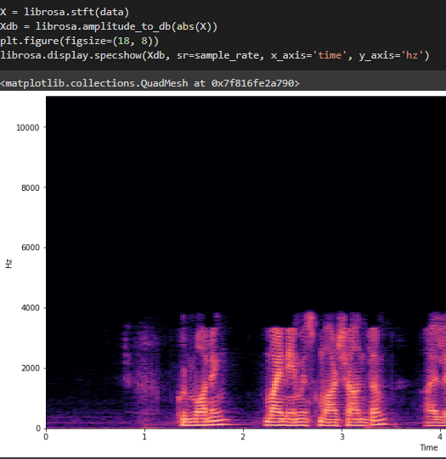
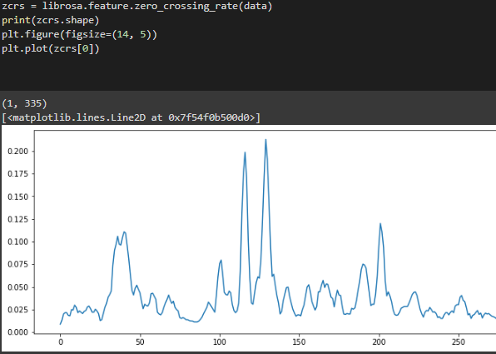
Feature Engineering
STFT (Spectrogram)
'.stft' converts data into short term Fourier transform. STFT converts signal such that we can know the amplitude of given frequency at a given time.
Zero Crossing Rate- The zero crossing rate indicates the number of times that a signal crosses the horizontal axis for measuring smoothness of a signal. ZCR is used for detecting the start and end positions of unvoiced sounds (ZCR is high around silence points).

Slide 10
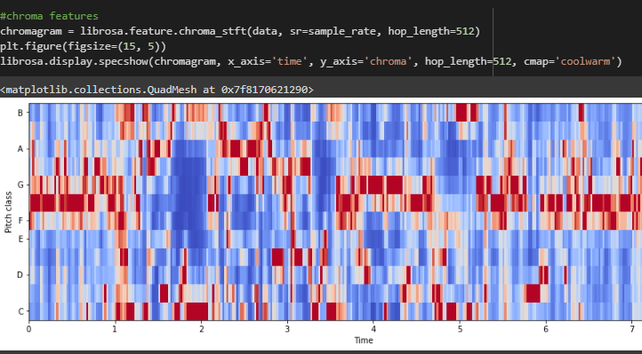
Feature Engineering
Spectral Moments: Moments is a term used in physics and statistics. There are raw moments and central moments (Mean, variance).
The spectral centroid (Wikipedia) indicates at which frequency the energy of a spectrum is centered upon. This is like a weighted mean.
Spectral rolloff is the frequency below which a specified percentage of the total spectral energy lies.
Spectral bandwidth computes the order-p spectral bandwidth.
Spectral contrast considers the spectral peak, the spectral valley, and their difference in each frequency subband.
Chromagram: A chroma vector is a typically a 12-element feature vector indicating how much energy of each pitch class, {C, C#, D, D#, E, ..., B}, is present in the signal.

Slide 11
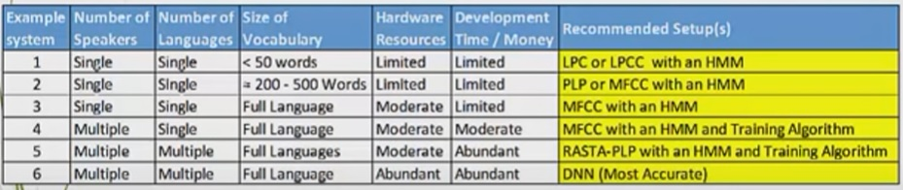
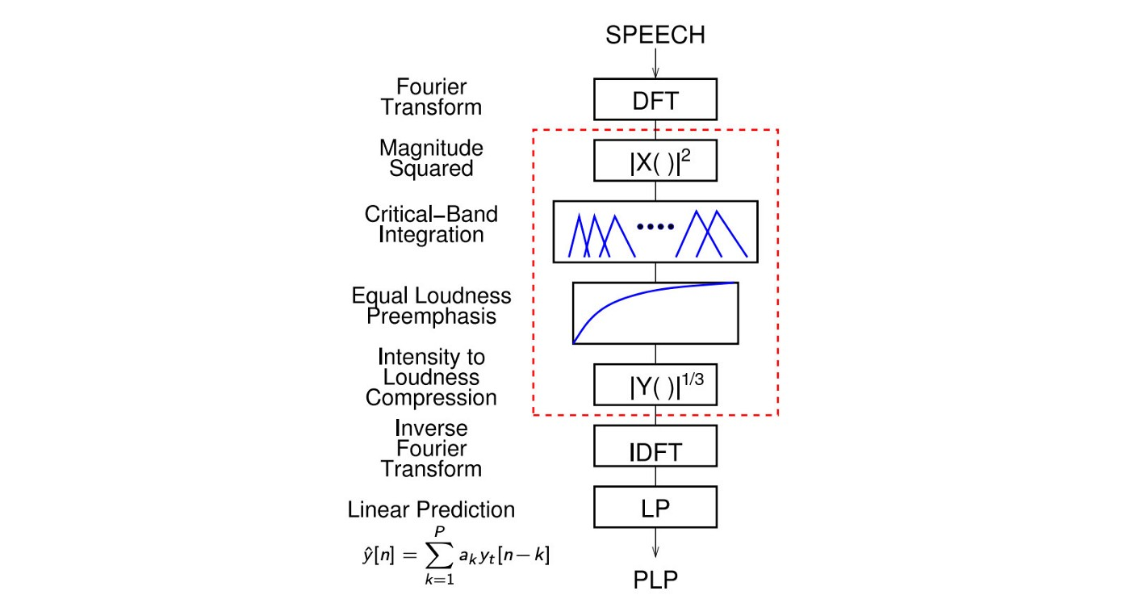
Feature engineering: Industry practices
PLP: Motivated by hearing perception, it uses equal loudness pre-emphasis and cube-root compression instead of the log compression. It also uses linear regressive to finalize the cepstral coefficients. PLP has slightly better accuracy and slightly better noise robustness.

Slide 12
Feature engineering: MFCC
Mel-frequency Cepstral coefficients is the most common method for extracting speech features. The human ear is a nonlinear system concerning how it perceives the audio signal. In order to cope with the change in frequency, the Mel-scale was developed to make a linear model of the human auditory system. Only frequencies in the range of [0,1] kHz can be transformed to the Mel-scale, while the remaining frequencies are considered to be logarithmic.
The MFCC feature extraction technique basically includes the following steps:
Window the signal
Apply Discrete Fourier Transform
Logarithm of the magnitude
Convert to a Mel scale
Apply inverse discrete cosine transform (DCT)
MFCC has 39 features. The feature count is small enough to force us to learn the information of the audio. 12 parameters are related to the amplitude of frequencies. It provides us enough frequency channels to analyze the audio.
MFCC features are highly unrelated. In ML, this makes our model easier to model and to train.
MFCC is not very robust against noise.
The feature extraction methods mentioned depend strongly on empirical results and observations. With the introduction of DL, we can train complex models with less hacking.

Slide 13
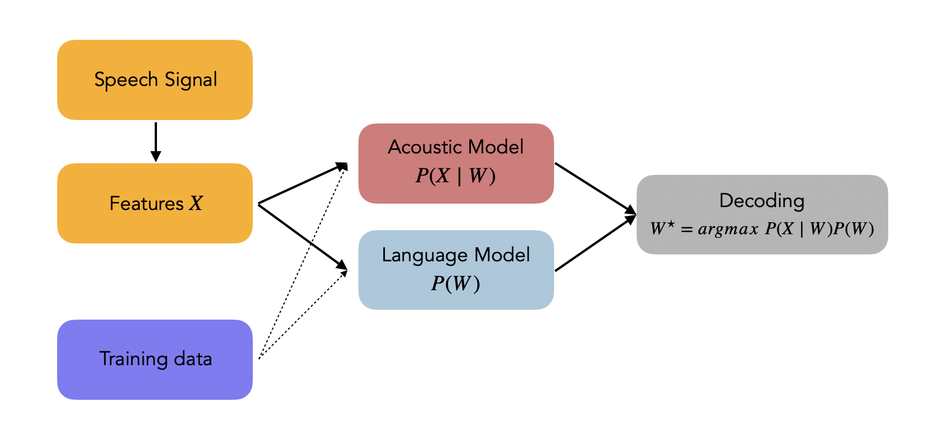
Statistical Approach to ASR
Source

Slide 14
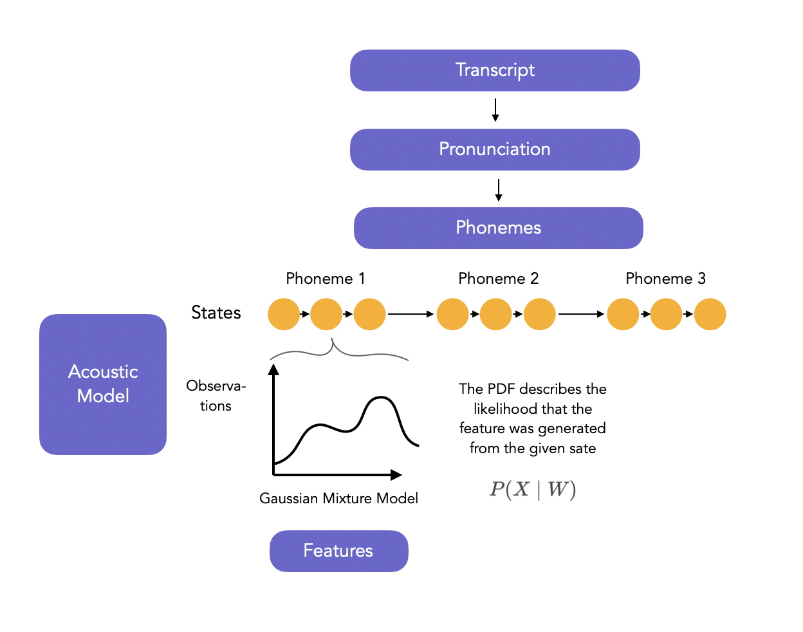
Acoustic Models: Hidden Markov Models
The acoustic model is a complex model that models the relation between the audio signal and the phonetic units of a language. It is mainly based on Hidden Markov Models and Artificial Neural Networks.
In isolated word/pattern recognition, the acoustic features (Y) are used as an input to a classifier to output the correct word. However, we take input sequence and should output sequences too when it comes to continuous speech recognition.
Hidden Markov Models are natural candidates for Acoustic Models since they are great at modeling sequences.
In HMMs, 1 phoneme is typically represented by a 3 or 5 state linear HMM (generally the beginning, middle and end of the phoneme).
The HMMs learns to give the probability of each end of phoneme at time t. It is assumed that the observations are generated by a mixture of Gaussians (Gaussian Mixture Models, GMMs) at each state- hence the model is called HMM-GMM.
The training of the HMM-GMM is solved by Expectation Maximization (EM).
In the EM training, the outputs of the GMM are used as inputs for the GMM training iteratively, and the Viterbi or Baum Welsch algorithm trains the HMM (i.e. identifies the transition matrices) to produce the best state sequence.
HMM-GMM Architecture

Slide 15
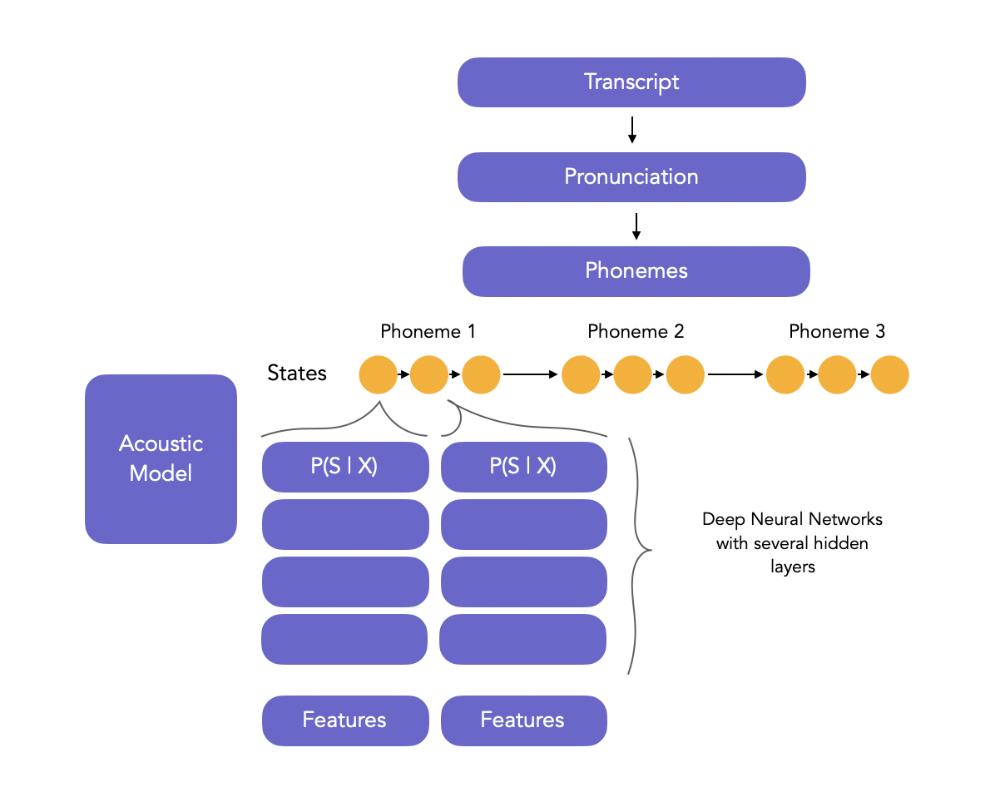
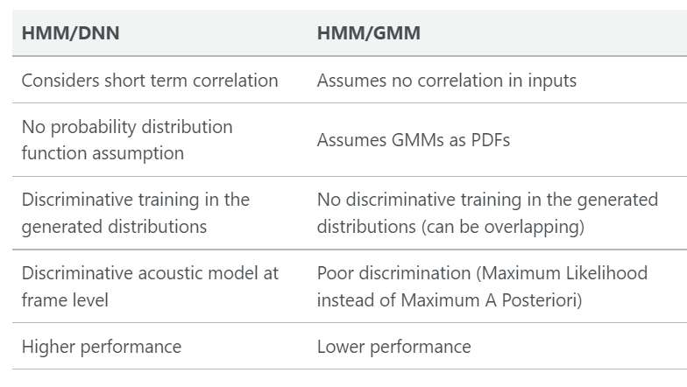
Acoustic Models: HMM-DNN
The aim of the DNN is to model the posterior probabilities over HMM states.Some considerations on the HMM-DNN framework:
we usually take a large number of hidden layers
the inputs features typically are extracted from large windows (up to 1-2 seconds) to have a large context
early stopping can be used
HMM-GMM Architecture

Slide 16
Pronunciation Model
The pronunciation dictionary is written by human experts, and defined in the IPA. The pronunciation of words is typically stored in a lexical tree, a data structure that allows us to share histories between words in the lexicon.
When decoding a sequence in prediction, we must identify the most likely path in the tree based on the HMM-DNN output. In ASR, most recent approaches are:
either end to end
or at the character level
In both approaches, we do not care about the full pronunciation of the words.
Grapheme-to-phoneme (G2P) models try to learn automatically the pronunciation of new words.

Slide 17
Language Models
The language model assigns a probability estimate to word sequences, and defines what the speaker may say, the vocabulary and the probability over possible sequences.
We calculate the maximum likelihood estimation of a sequence (relative frequency) and the probability of the whole sequence is given by a chain rule of probabilities. This approach starts to fail for long sequences (as repeated number of 0s in the chain leads to overall probability 0). Evaluation metric utilized- Perplexity (PP), the lower the perplexity score the better.
Solutions: Smoothing (Laplace smoothing, Add-k smoothing), N-gram language model.
The idea behind the n-gram model is to truncate the word history to the last 2, 3, 4 or 5 words, and therefore approximate the history of the word.
With N-grams, it is possible that we encounter unseen N-grams in prediction. There is a technique called backoff that states that if we miss the trigram evidence, we use the bigram instead, and if we miss the bigram evidence, we use the unigram instead.
Another approach is linear interpolate, where we combine different order n-grams by linearly interpolating all the models.

Slide 18
Deep Neural Networks: RNN
In the voice recognition challenge, neural networks showed remarkable progress. Various approaches have been used, including convolutional neural networks (CNNs), recurrent neural networks (RNNs), and, more recently, Transformer networks. Neural networks, both feed-forward and recurrent, can be only used for frame-wise classification of the input audio.
Recurrent Neural Networks
RNNs perform computations on the time sequence since their current hidden state is dependent on all the previous hidden states. More specifically, they are designed to model time-series signals as well as capture long-term and short-term dependencies between different time-steps of the input. One major drawback of the simple form of RNNs is that it generates the next output based only on the previous context.
Bidirectional RNNs (BiRNNs) are commonly selected in order to address this shortcoming. BiRNNs process the input vectors in both directions i.e., forward and backward, and keep the hidden state vectors for each direction.
LSTM networks can be utilized for large vocabulary speech recognition. This method extracts high-dimensional features using mel-filter banks using a sliding window technique. In addition, we can incorporate context-dependent states and further improve the performance of the model. Source

Slide 19
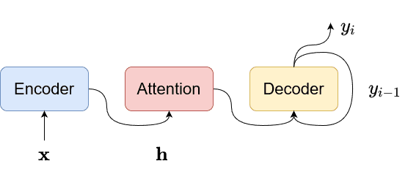
Deep Neural Networks: RNN with attention
Attention Based Models
The attention encoder-decoder structure of the RNN can directly compute the conditional probability of the output sequence given the input sequence without assuming a fixed alignment. The encoder-decoder method uses an attention mechanism, which does not require pre-segment alignment of data. An attention-based model uses a single decoder to produce a distribution over the labels conditioned on the full sequence of previous predictions and the input audio. With attention, it can implicitly learn the soft alignment between input and output sequences, which solves a big problem for speech recognition.
The model can still have a good effect on long input sequences, so it is also possible for such models to handle speech input of various lengths. Source
Listen-Attend-Spell (LAS): The encoder takes the input audio x and generates the representation h. More specifically, it uses a bidirectional Long Short Term Memory (BLSTM) module with a pyramid structure, where in each layer the time resolution is reduced. The decoder (i.e., Attend-Spell) is an attention-based module that attends the representation h and produces the output probability P(y∣x). It was able to achieve great recognition rates with WERs of 10.3% and 12.0% on clean and noisy environments, respectively. Source

Slide 20
Little bit about Attention…
The seq2seq models is normally composed of an encoder-decoder architecture, where the encoder processes the input sequence and encodes/compresses/summarizes the information into a context vector (also called as the “thought vector”) of a fixed length. The decoder is then initialized with this context vector, using which it starts generating the transformed output. Example of a Seq2Seq model.
A critical and apparent disadvantage of this fixed-length context vector design is the incapability of the system to remember longer sequences. Often is has forgotten the earlier parts of the sequence once it has processed the entire the sequence. The attention mechanism was born to resolve this problem.
For a seq2seq model, while traversing through the individual characters in the input string a compact information of the word is present for the model to infer- this means that the intermediate transition stages (moving from one character to another) are neglected.
The central idea behind Attention is not to throw away those intermediate encoder states but to utilize all the states in order to construct the context vectors required by the decoder to generate the output sequence.
Each intermediate stage is assigned a weight and these intermediate stages or attention factors show the network what word in the input gets better associated with the output word to be predicted.
This simply means that for a particular word the network does not have to pay attention to the entire sequence and just the specific hidden encoder state and send it to the decoder.
Read

Slide 21
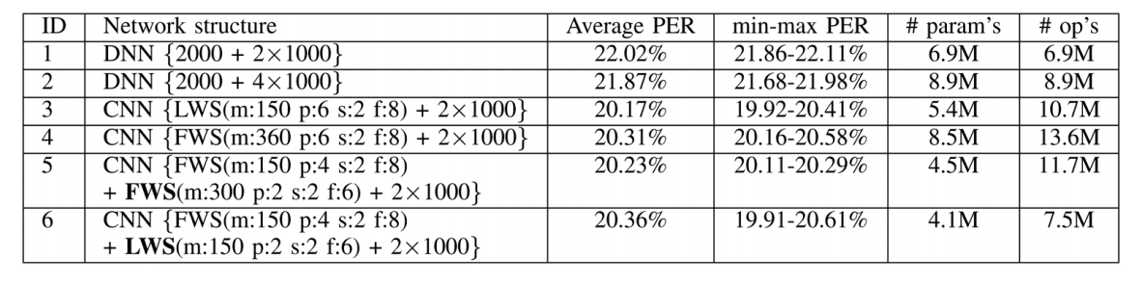
Deep Neural Networks: CNN
Convolutional Neural Networks
Convolutional neural networks were initially implemented for computer vision (CV) tasks. In recent years, CNNs have also been widely applied in the field of natural language processing (NLP), due to their good generation, and discrimination capability.
A very typical CNN architecture is formed of several convolutional and pooling layers with fully connected layers for classification. A convolutional layer is composed by kernels that are convolved with the input. A convolutional kernel divides the input signal into smaller parts namely the receptive field of the kernel. Furthermore, the convolution operation is performed by multiplying the kernel with the corresponding parts of the input that are into the receptive field.
2D-CNNs construct 2D feature maps from the acoustic signal. Similar to images, they organize acoustic features i.e., MFCC features, in a 2-dimensional feature map, where one axis represents the frequency domain and the other represents the time domain. In contrast, 1D-CNNs accept acoustic features directly as input. Source

Slide 22
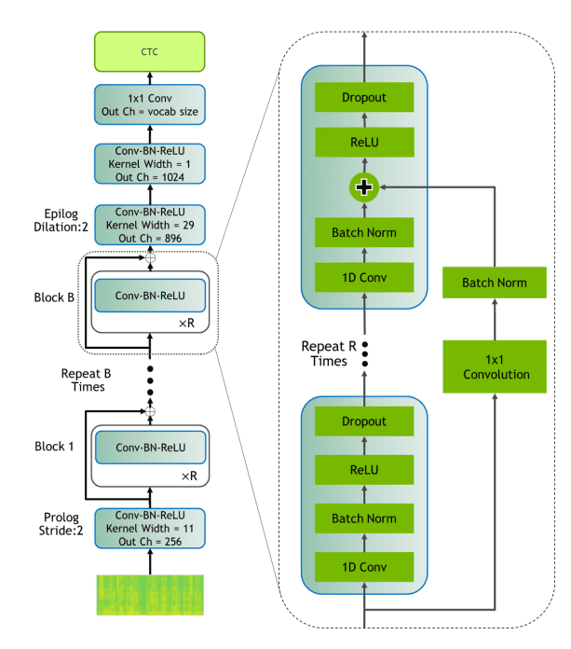
Deep Neural Networks: CNN
Jasper
Jasper is a residual 1D-CNN with dense and residual blocks as shown below. The network extracts mel-filter-bank features and uses residual blocks that contain batch normalization and dropout layers for faster convergence and better generalization. he input is constructed from mel-filter-bank features obtained using 20 msec windows with a 10 msec overlapping. The network has been tested with different types of normalization and activation functions, while each block is optimized to fit on a single GPU kernel for faster inference. Jasper is evaluated on LibriSpeech with different settings of configuration. The best model has 10 blocks of 4 layers and BatchNorm + ReLU and achieves validation WERs of 6.15% and 17.38% on clean and noisy sets, respectively. Source

Slide 23
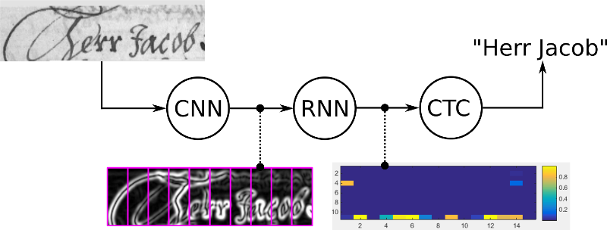
Deep Neural Networks: CTC
Connectionist Temporal Classification (CTC)
CTC is an objective function that computes the alignment between the input speech signal and the output sequence of the words. CTC uses a blank label that represents the silence time-step i.e., the person doesn't speak, or represents the transition between words or phonemes.
CTC aims to maximize the total probability of the correct alignments in order to get the correct output word sequence. One main benefit of CTC is that it doesn't require prior segmentation or alignment of the data. DNNs can be used directly to model the features and achieve great performance in speech recognition tasks.
It is only required to feed the output matrix of the NN and the corresponding ground-truth (GT) text to the CTC loss function. But how does it know where each character occurs? Well, it does not know. Instead, it tries all possible alignments of the GT text in the image and takes the sum of all scores. This way, the score of a GT text is high if the sum over the alignment-scores has a high value.

Slide 24
Improving predicted text
Similar sounding phonetics can introduce error in texts.
Overview of some decoding algorithms (some might have a language model) to tackle the issue:
Best path decoding only uses the output of the NN (i.e. no language model) and computes an approximation by taking the most likely character at each position.
Beam Search also only uses the NN output, but it uses more information from it and therefore produces a more accurate result. It allows arbitrary character strings, which is needed to decode numbers and punctuation marks.
Beam Search with character-LM additionally scores character-sequences (e.g. “an” is more probable than “oi”) which further improves the result.
Token passing algorithm uses a dictionary and word-LM. It searches for the most probable sequence of dictionary words in the NN output. Token passing limits its output to dictionary words, which avoids spelling mistakes. Of course, the dictionary must contain all words which have to be recognized.
Beam Search algorithm: the algorithm iterates through the NN output and creates text candidates (called beams). Starting with the empty beam, then add all possible characters (we only have “a” and “b” in this example) to it in the first iteration and only keep the best scoring ones. The beam width controls the number of surviving beams. This is repeated until the complete NN output it processed.
We want the algorithm to behave differently when it recognizes a word and when it recognizes a number or punctuation marks. To tackle this,we add a state variable to each beam.

Slide 25
Improving predicted text
A beam is either in word-state or in non-word-state. If the beam-text currently is “Hel”, then we are in word-state and only allow adding word-characters until we have a complete word like “Hell” or “Hello”. A beam currently in non-word-state could look like this: “She is 3”.
Going from word-state to non-word-state is allowed when a word is completed: then we can add a non-word-character to it, like if we have “Hello” and add “ “ to it we get “Hello “. The other direction from non-word-state to word-state is always allowed, like in “She is 33 “, where we may add the word-character “y” to get “She is 33 y” (and later, maybe, will get “She is 33 years old.”).
When in word-state, we only allow adding characters which eventually will form words.
In each iteration, we at most add one character to each beam, so how do we know which characters will, after adding enough characters, form a word? - using a prefix tree. A tree can be made with nodes associating the letters of a word.
Given a prefix, which characters can be added to eventually form a word? Simply go to the prefix’s node in the prefix tree by following the edges labeled with the prefix’s characters, and then collect the labels of the outgoing edges of this node. If we are given the prefix “th”, then the possible next characters are “i” and “a”.
Given a prefix, which words can be created out of it? From the prefix’s node, collect all descendant nodes which are marked as a word. If we are given the prefix “th”, then the possible words are “this” and “that”.
We only keep the best-scoring beams per iteration. The score depends on the NN output.

Slide 26
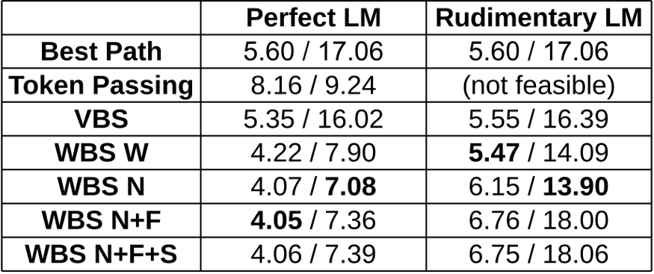
Improving predicted text
We can also incorporate a word-LM with different scoring modes:
Create constraints (prefix tree) using a dictionary.
Score by LM each time a word is fully recognized (N). Suppose we have a beam “My nam”. As soon as an “e” is added and therefore the last word “name” is finished, the LM scores seeing “My” and “name” next to each other.
Look into the future (N+F): with the help of the prefix tree, we know which words might occur in later iterations. A beam “I g” might be extended to “I go”, “I get”, … So instead of waiting until a word is finished to apply the LM-score to a beam, we can also do it in each iteration by summing over the LM-scores of all possible words, this would be “I” and “go”, “I” and “get”, … in the mentioned example. A small performance improvement can be achieved by only taking a random subset (N+F+S) of the words.
Code
Results given as CER [%] / WER [%] for different algorithms (VBS: vanilla beam search, WBS: word beam search, W: no LM used, N: LM used, N+F: LM with forecasting, N+F+S: LM with forecasting and sampling) and training texts for the LM (perfect and rudimentary LM). A small CER/WER means that we have a well performing algorithm. Source

Slide 27
Interesting Reads..
Basics of Semantic Analysis techniques
Speech to semantics: This paper talks about an SLU model, an ASR model combined with NLU subsystems, ASR incorporating semantic information from NLU and also improves NLU by exposing it to ASR confusion encoded in the hidden layer.
Search and Learn: Improving Semantic Coverage for Data-to-Text Generation proposes a search-and-learning approach that leverages pretrained language models but inserts the missing slots (pretrained language models suffers from low semantic coverage problem) to improve the semantic coverage. Further fine tuning of the system based on the search results to smooth out the search noise yielded better-quality text and improving inference efficiency to a large extent.

